Slide 1
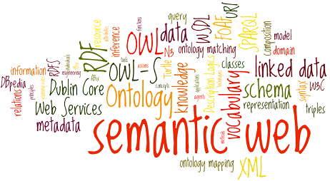
Introduction To Semantic Web
Prepared By: DR. Ronak Panchal
KNOWLEGDE GRAPH ENGINEER, COGNIZANT, PUNE

Slide 2
Agenda
History of Semantic Web
Introduction to semantic and semantic web
Applications of Semantic Web and Semantic web enable search engine
Difference between Semantic Web and Current WebArchitecture of semantic web
semantic web standers - RDF, Ontology and SPARQL
Introduction to Protégé Editor
Introduction to SPARQL and Samples queries
Practical Demos
References

Slide 3
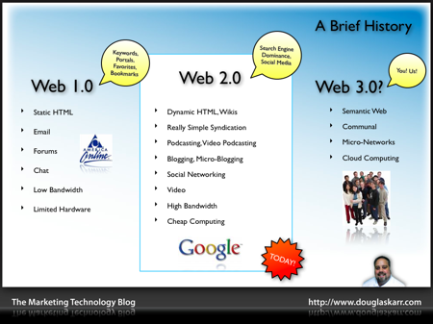
Current Era

Slide 4
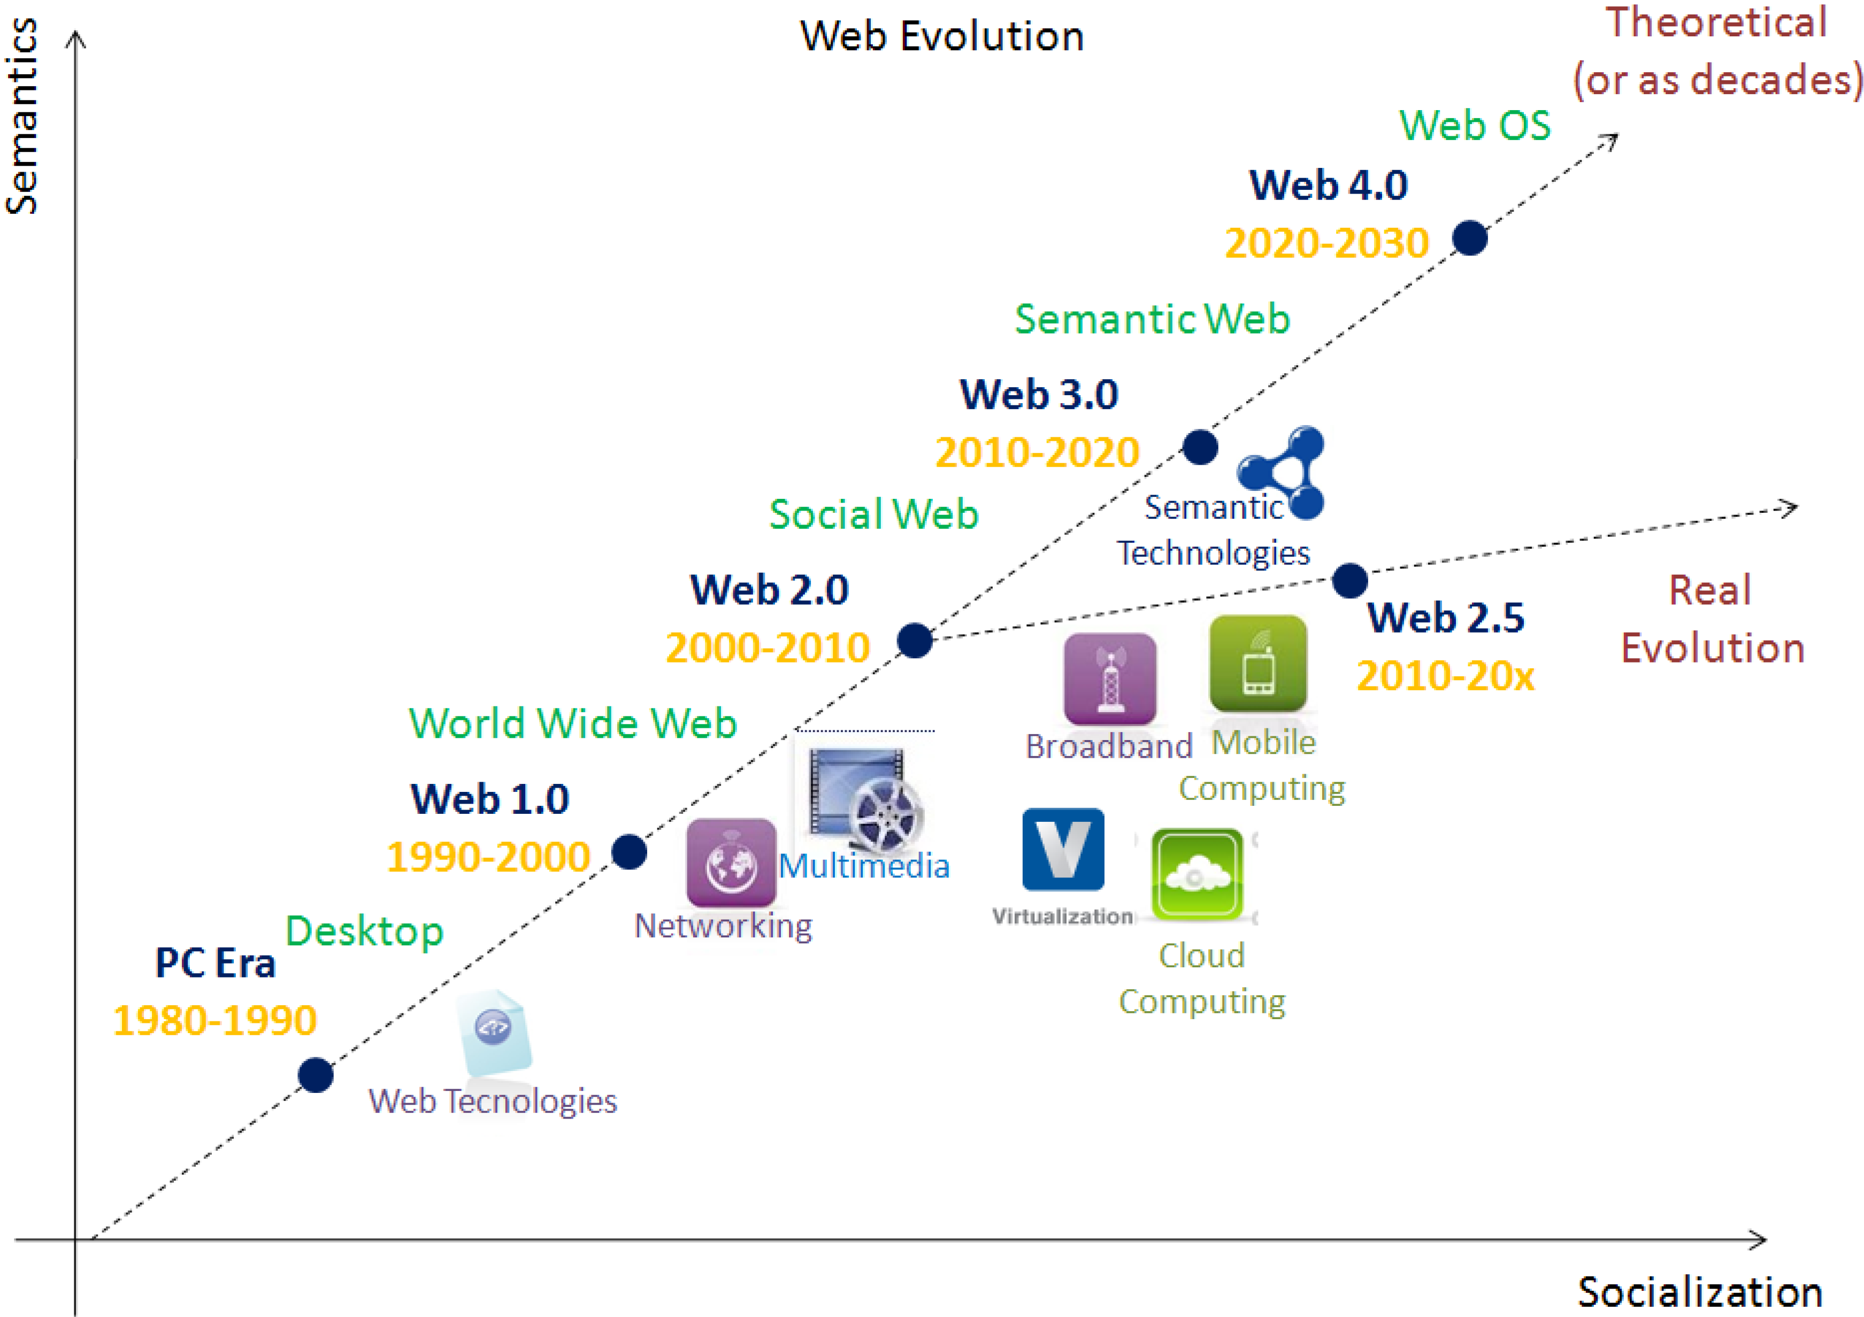

Slide 5
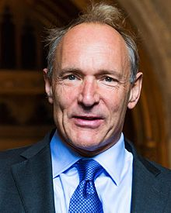
History of Semantic Web
The inventor of the World Wide Web, Sir Tim Berners-Lee, and also build HTML and URL.
He is current appointments as Senior Research Scientist at MIT's Computer Science and Artificial Intelligence Laboratory, and
He is Director of the World Wide Web Consortium (W3C).
He is closely involved with the evolution of the Semantic Web, which is Tim's vision for the future of the Web.
The ARPANET community expanded the WWW.
He has contributed to develop first web browser MOSAIC (Navigator).

Slide 6
Introduction to semantic and semantic web
Semantic is study of meaning. It explain how we derive meaning from words or symbols.
The Semantic Web has been described by Tim Berners-Lee as 'an extension of the current web in which information is given well-defined meaning, better enabling computers and people to work in co-operation’.
The Semantic Web is an extension of the traditional Web (World Wide Web) through standards set by the World Wide Web Consortium (W3C).
Basic benefits of semantic web are :
Allowing machines to understand data
Ease sharing and mixing data
Extend the World Wide Web rather than replace it
Semantic Web main standards - RDF, OWL, SPARQL
Notes:
Hello Everyone, Welcome to my course.
Internet is already big enough but researchers feel Internet can do much much better if we can convert the tones of web pages into tons of Data which is meaningful to the machines. Creating the meanings of the bulk of web pages should not be only the Humans responsibilities.
Imagine how many problems machines can solve if they can understand the data available on the entire World Wide Web. That's exactly is being tried out by Semantic Web. It is far more interesting than it sounds like.
In this course I will take you through why & how the semantic web can supercharge the existing Internet and create the next generation machines from that data. We will explain how a web developer can make her website semantic friendly & allow others make more sense of listed pages.
This course allows you to learn the semantic web in the most easy way within one hour by explaining everything using examples. This is the good starting point to explore the deep world of WWW.
We will also explain the standards like RDF, OWL Triples etc.
Who this course is for:
Anyone who want to keep up with the latest technologies trends
Students who are working on Semantic Web Project
Professional working on Website Upgrade to make it Semantic Web Compatible
Entrepreneurs & Business Professionals who are interested in making their business more meaningful on Web

Slide 7
Related Terms of Semantic Web
Synonymous or related to:
Web of data
Linked data (cloud)
Giant Global Graph (GGG)
Web 3.0
Open Data
Big Data
Knowledge Graph

Slide 8
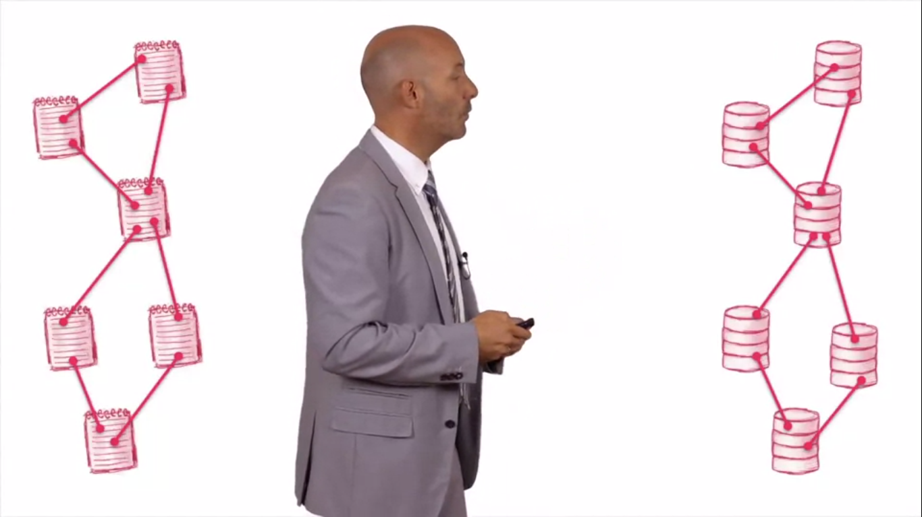
Without semantic web, documents are linked.
In semantic web, Data or Data sources are directly linked.

Slide 9
Application of Semantic Web
Google
Facebook
Webmaster tools
Knowledge graph
Freebase
ORACLE
Open Graph Protocol
Oracle 11g : Triplestore, Reasoner
Government/public data
Thousands of datasets Some offered in RDF
IBM
IBM DB2
Open Services Lifecycle Collaboration
Linked Data Platform
Academic work
Gene research
Language processing
Semantic MediaWiki

Slide 10
Other Semantic Web Applications
Content management
Business intelligence
Collaborative user interfaces
Sensor-based services
Linking virtual communities
Grid infrastructure
Multimedia data management

Slide 11
Leading companies of Semantic Web
Google, Microsoft, and Yahoo Team Up to Advance Semantic Web - A push to add meaning to Web pages to aid search could also enable other kinds of intelligent web apps.
National Aeronautics and Space Administration (NASA) on building systems based on semantic-web concepts and technologies.
PoolParty’s Case Study: Semantic Web Technology for Public Health Situation Awareness
https://www.ranker.com/list/semantic-web-companies/reference

Slide 12
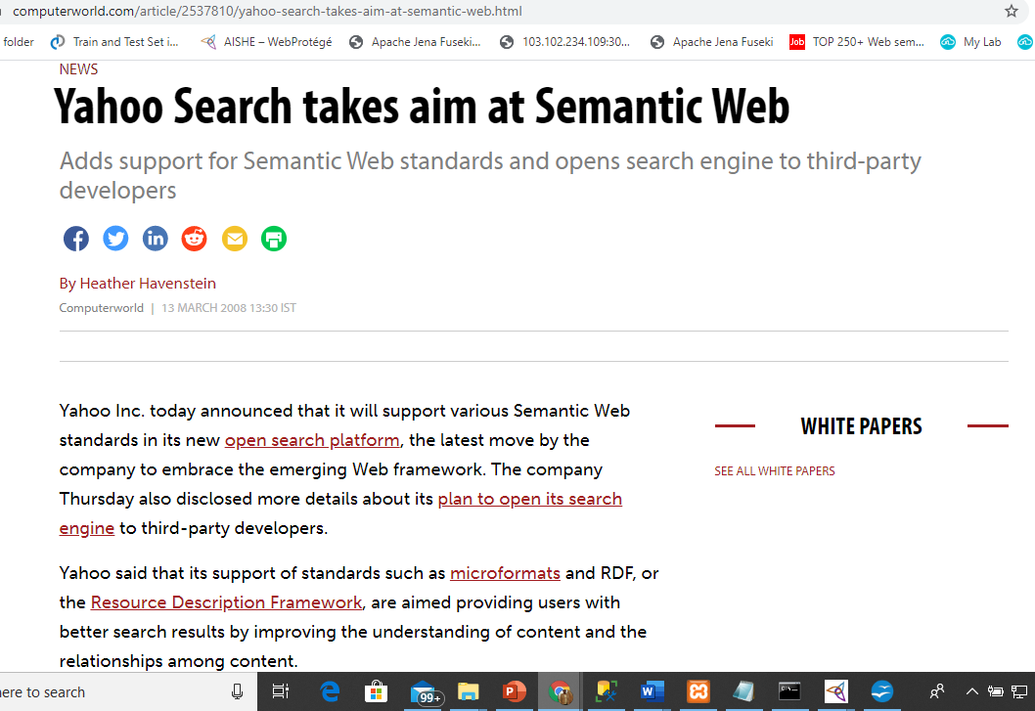
Yahoo uses Sematic Web
“Back-end” is built using SW tools
common (RDF) data model for data, metadata, relationships, constraints expressed in OWL, Rules

Slide 13
Who actually does the Semantic Web?
Linked data
Open data
Dbpedia
Freebase
Geonames
Social data
Media
Government data
Publications
OKG
Many many other
datahub.io
lod.openlinksw.com
data.gov
data.gov.uk
datadotgc.ca
openlibrary.org
bnb.data.bl.uk

Slide 14
Semantic Web enabled search engine
WalmartLabs(Kosmix)
Exalead
SenseBot
Cognition Search
Lexxe
Swoogle
Factbites
Yummly
Hakia
DuckDuckGo( Sudeepthi, Anuradha, Surendra, & Babu, 2012)

Slide 15
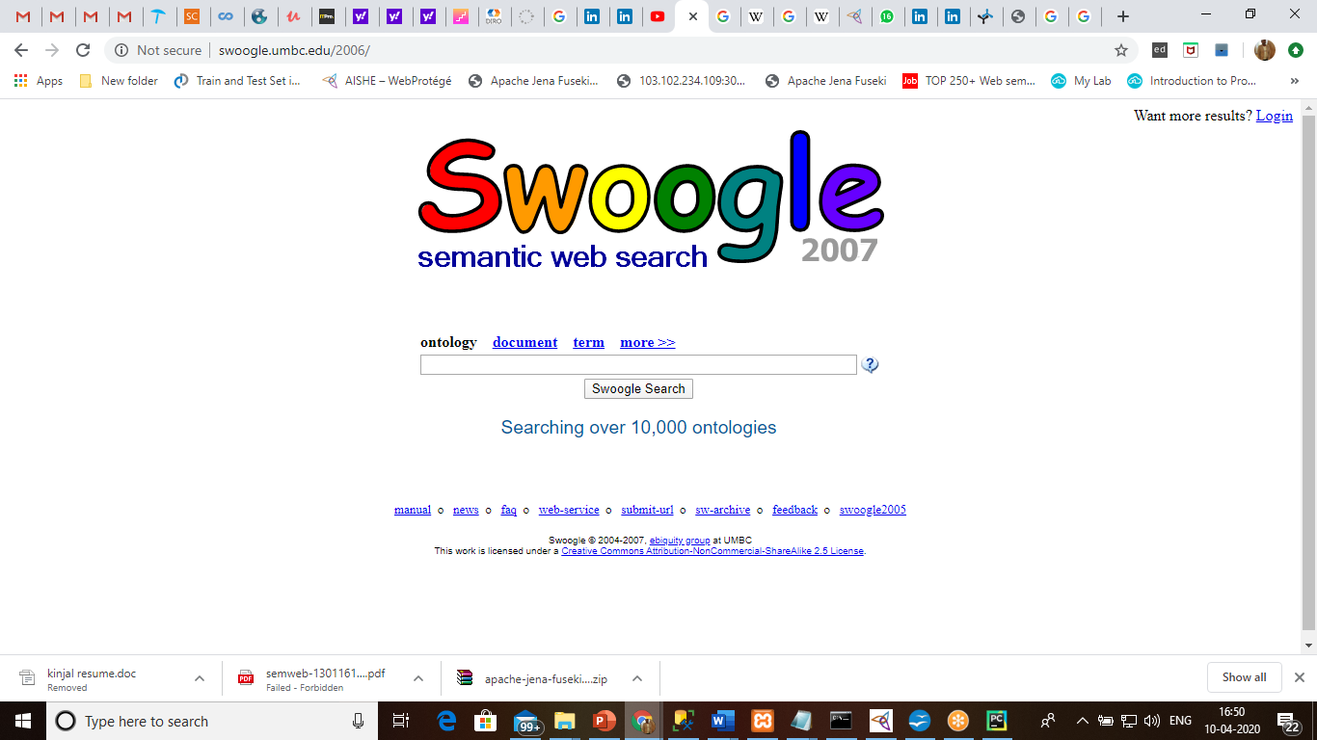
We can search instance from ontology using swoogle.

Slide 16
Current Web vs Semantic web
Sr No | Current Web | Semantic Web
1 | Current web contents are machine-readable but not machine understandable | Semantic web contents are machine-readable and machine understandable
2 | Current web is just like a book, having multiple hyperlinked documents. | In Semantic Web, Data is given well-defined meaning, understandable by machines.
3 | Current web is called a web of documents containing data. | Semantic web is the web of ontologies having data with formal meaning.

Slide 17
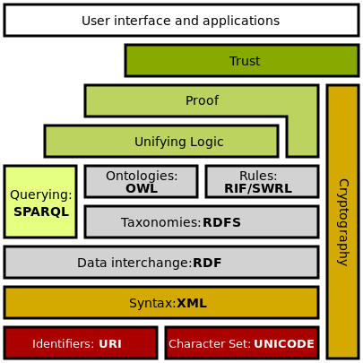
Architecture of semantic web
A layered architecture proposed by Tim Berners-Lee for the Semantic Web applications.

Slide 18
URI, URL, URN and Namespaces
URI
URL
URN
URI: Uniform Resource Identifier. URI is a text which is used to Identify any resource or name on Internet.

Slide 19
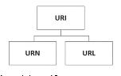
URL and URN
URL (Uniform Resource Locator): URL includes location as well as the protocol to retrieve the resource (For example: HTTP Protocol is used to retrieve resource)
http://example.com/mypage.html
ftp://example.com/download.zip
mailto:user@example.com
File://home/user/file.txt
URN (Uniform Resource Name): Identifies a resource by a unique and persistent name, but doesn’t necessarily tell you how to locate it on the Internet. It usually starts with the prefix urn:
For example:
urn:isbn:97819219123 to identify a book by its ISBN number.

Slide 20
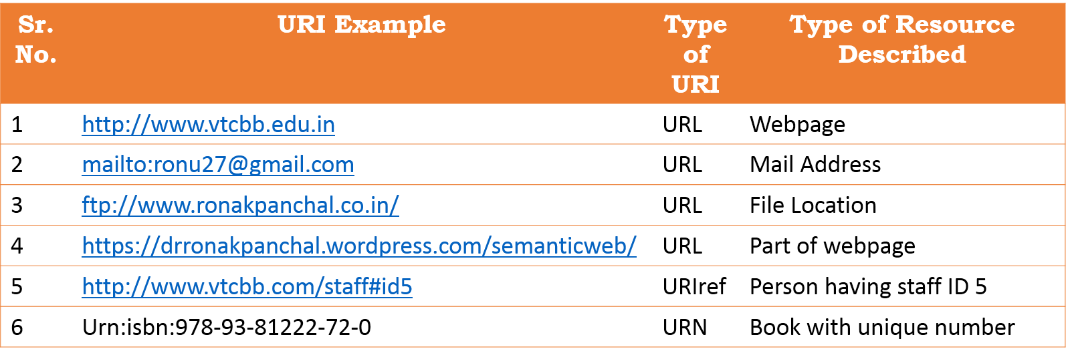
The Internationalized Resource Identifier (IRI) is an internet protocol standard which builds on the Uniform Resource Identifier (URI) protocol by greatly expanding the set of permitted characters.

Slide 21
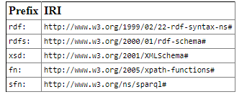
Namespace
Namespaces are based on the domain name system of the Internet. Your namespace is an identity space on the Internet that you control. For example: Veer narmad south Gujarat university owns the namespace vnsgu.ac.in; Ronak Panchal owns namespace related to resume is drronakpanchal.wordpress.com/resume/
The following standard namespace prefix:

Slide 22
RDF: Resource Description Framework
The RDF is a language for representing information about resources in the World Wide Web. RDF/XML is syntax to express a RDF graph as a XML document.
RDF data is represented as RDF graphs
RDF model is representing in distribute and decentralize.
RDF graphs are collections of statements called triples
Each triple contains a subject, verb (also called predicate) and object
subject - Ronak verb/predicate - is a object - Person
DISEASE
IsDiagonosedBy
SYMPTOM
RONAK
is a
PERSON
Subject
Predicate
Object

Slide 23
What is the Purpose of RDF?
The purpose of RDF is to give a standard way of specifying data "about" something.
Here's an example of an XML document that specifies data about India's Narmada river:
<?xml version="1.0"?>
<River id="Narmada“ xmlns="https://en.wikipedia.org/wiki/Narmada_River">
<length>1,312 kilometers</length>
<startingLocation>Amarkantak Plateau Madyapradesh</startingLocation>
<endingLocation>Gulf of Khambhat near Bharuch</endingLocation>
</River>
"Here is data about the Narmada River. It has a length of 1312 kilometers. Its startingLocation is north India’s Amarkantak Plateau. Its endingLocation is the south Gujarat Gulf of Khambhat, near Bhruch"

Slide 24
XML converted into RDF
Below RDF file is : Narmada.rdf which is converted from : Narmada.xml file.
<?xml version="1.0"?>
<River rdf:ID="Narmada"
xmlns:rdf="http://www.w3.org/1999/02/22-rdf-syntax-ns#"
xmlns="https://en.wikipedia.org/wiki/Narmada_River#">
<length>1,312 kilometers</length>
<startingLocation>Amarkantak Plateau Madyapradesh</startingLocation>
<endingLocation> Gulf of Khambhat near Bharuch</endingLocation>
</River>

Slide 25
OWL: Web Ontology Language
OWL represents the meaning of terms in vocabularies and the relationship between RDF triples.
This representation of terms is called an Ontology
An Ontology is a formal specification of shared conceptualization – Tom Gruber (He did foundational work in ontology engineering and is well known for his definition of ontologies in the context of artificial intelligence)

Slide 26
Example of ontology
Dublin core - They have an ontology for metadata of data. Their ontology set includes classes, properties, vocabulary encoding schemes, syntax encoding schemes and collections. All of them have several set of RDFs explaining what the data is about.
Dbpedia - It would be fair to say that Dbpedia is a Semantic web version of Wikipedia. The Dbpedia ontology is massive and has 4.2 million instances of objects which include things, person, place, work, organization and species. This massive amount of data is structured using RDF and OWL.
There are various other examples of ontologies like FOAF ( Friend of a Friend), Good Relations, Music Ontology, Upper Merged Ontology, SKOS, Gene Ontology etc.

Slide 27
Various file extensions of Ontology
SrNo | Ontology file name | File extension
1 | Trix | .trix
2 | OWL Functional Syntax | .owl
3 | OBO format | .obo
4 | KRSS2 Syntax | .krss
5 | OWL/XML Syntax | .owl
6 | RDF/XML Syntax | .rdf
7 | RDF/JSON | .rj
8 | Notation3, or N3 | .n3
9 | Manchester OWL Syntax | .omn
10 | N-Triples | .ntriples or .nt
11 | JSON-LD | .json
12 | N-Quads | .nq
13 | TriG | .trig
14 | Turtle or Turtle Syntax | .turtle or .ttl
15 | LaTeX Syntax | .tex

Slide 28
Semantic Web Development tools
Programming tools
Design tools and frameworks
dotNetRDF
Jena/ARQ
Rdflib
RDF.rb
EasyRdf
Rdfquery
Redland
OWLAPI
Protégé
WebProtege
Apache Jena Fuskei
TopBraid Composer
NeOn
OntoWiki
Semantic MediaWiki
Cubic Web

Slide 29
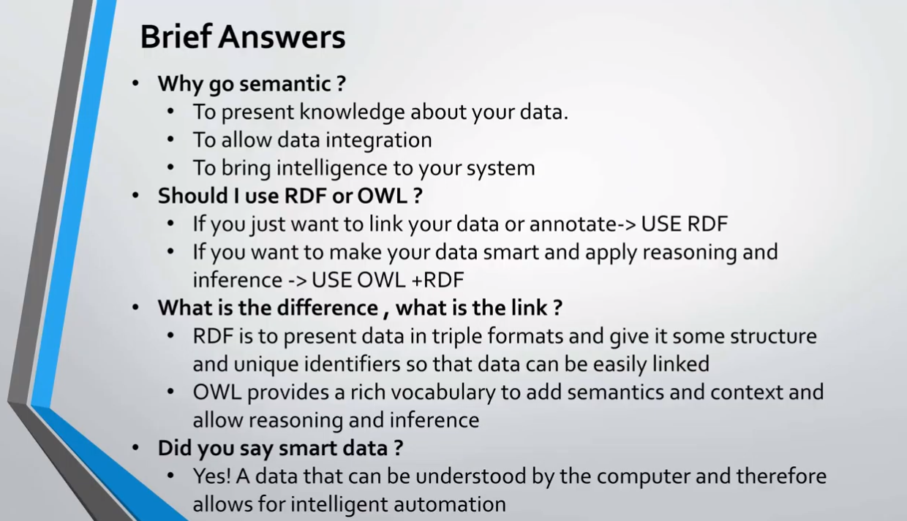

Slide 30
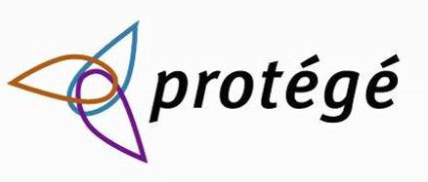
Introduction to protégé editor
Developed by Biomedical Informatics Research, Stanford University, USA
It release in 11 November 1999; 20 years ago
Has a large user community (approx 300k),
Free, open source ontology editor and knowledge-base framework
Download from https://protege.stanford.edu/

Slide 31

Introduction to protégé editor (continue…)
Based on Java, is extensible,
Provides a plug-and-play environment
Supported by a strong community of developers and academic, government and corporate users

Slide 32
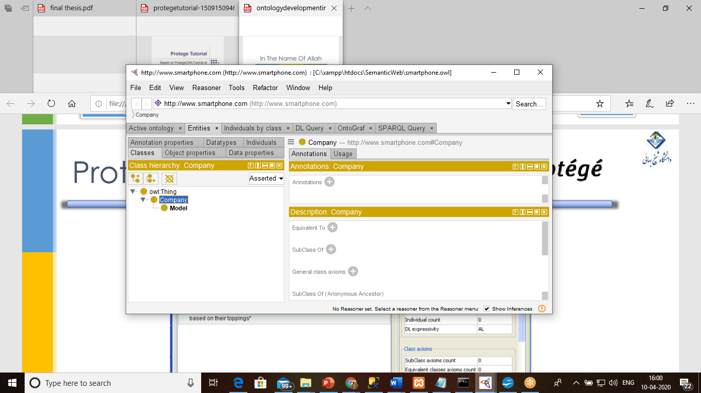
What can you do with Protégé?
Create a new ontology from scratch
Download and extend an existing ontology
Export ontologies in a variety of formats
OWL
RDF
XML Schema

Slide 33
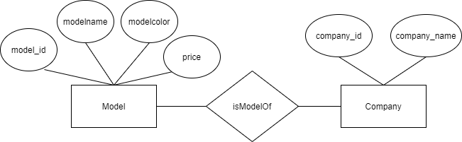
Entity – Relationship Diagram
“6s” is model of “Apple”
“Note 10” is model of “Samsung”
Drow.io website is free online diagram software for making flowcharts, process diagrams, org charts, UML, ER and network diagrams.

Slide 34
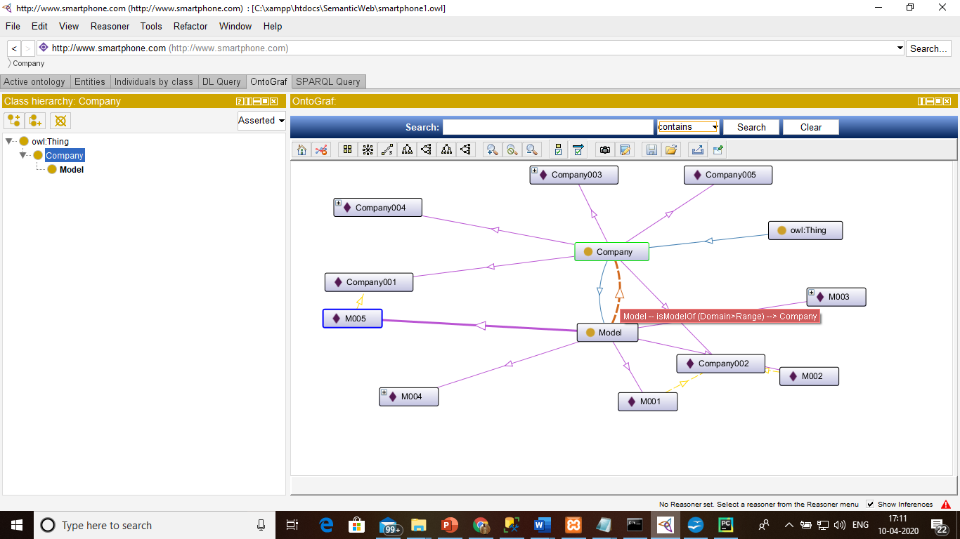
Protégé OntoGraf
There are two class Company and Model.
Others nodes are Individuals.

Slide 35
Introduction to SPARQL
SPARQL Protocol and RDF Query Language
Remote queries through SPARQL Endpoints
SPARQL 1.1 features:
ASK, SELECT, DESCRIBE, CONSTRUCT,
Aggregates,
Federated queries,
Extensibility, XPath, subqueries
SPARQL Update

Slide 36
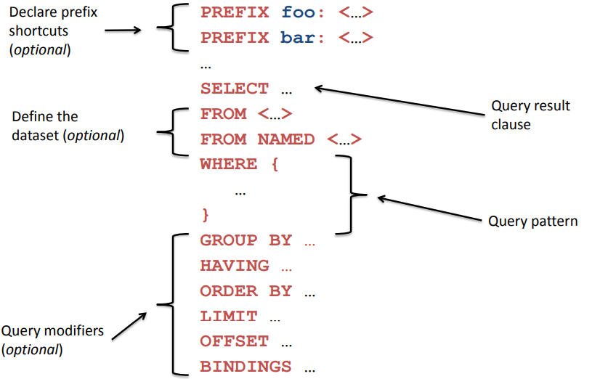
Anatomy of a SPARQL Query

Slide 37
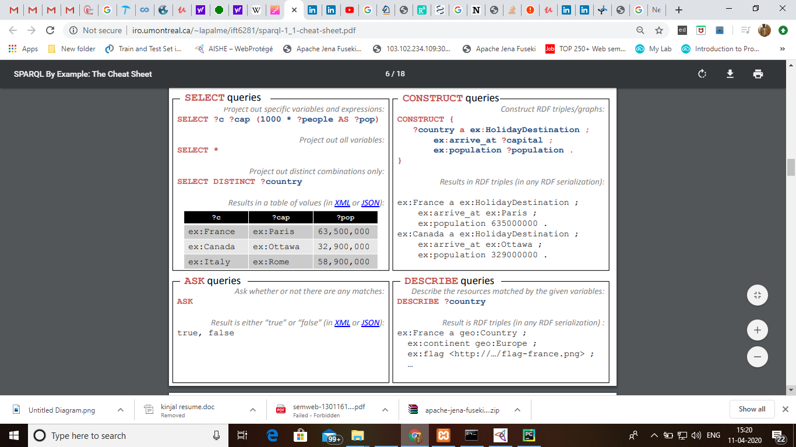
Type of SPAQL

Slide 38
List of SPARQL Prefix
prefix... | Predefined URI
rdf: uri is | http://xmlns.com/foaf/0.1/
rdfs: uri is | http://www.w3.org/2000/01/rdf-schema#
owl: uri is | http://www.w3.org/2002/07/owl#
xsd: uri is | http://www.w3.org/2001/XMLSchema#
dc: uri is | http://purl.org/dc/elements/1.1/
foaf: uri is | http://xmlns.com/foaf/0.1/

Slide 39
SPARQL Query Tools
Protégé tool is free, open source ontology editor and support of SPARQL Query except Insert, Update or Delete operation.
Flint, Gephi and Corese tool for SPARQL query
ARQ tool provide the support of a SPARQL based processor for Jena RDF also support of SPARQL Query
Twinql tool provide GUI a SPARQL
Pellet tool is a free, costless, without license OWL DL reasoner in Java, that has half provision of SPARQL query
KAON2 tool provides OWL DL reasoner that has partial SPARQL support.
DBpedia community provides SPARQL support
Apache Jena Fuseki Server tool provides a web based SPARQL query process and creating-maintain dataset.

Slide 40
Basic SPARQL query for retrieving subject, predicate and object
SELECT ?subject ?predicate ?object
WHERE {
?subject ?predicate ?object
}
LIMIT 25

Slide 41
Display classes of ontology
prefix owl: <http://www.w3.org/2002/07/owl#>
prefix rdfs: <http://www.w3.org/2000/01/rdf-schema#>
SELECT DISTINCT ?class ?label ?description
WHERE {
?class a owl:Class .
OPTIONAL { ?class rdfs:label ?label}
OPTIONAL { ?class rdfs:comment ?description}
} LIMIT 25

Slide 42
Display subclasses from ontology
PREFIX rdf: <http://www.w3.org/1999/02/22-rdf-syntax-ns#>
PREFIX owl: <http://www.w3.org/2002/07/owl#>
PREFIX rdfs: <http://www.w3.org/2000/01/rdf-schema#>
PREFIX xsd: <http://www.w3.org/2001/XMLSchema#>
SELECT ?subject ?object
WHERE
{
?subject rdfs:subClassOf ?object
}

Slide 43
Practical Demo
Creating ontology and queries in Protégé Editor
Retrieving Data from Ontology using Python Code

Slide 44
References
https://www.ecs.soton.ac.uk/news/658 – About Tim Berners Lee
https://www.cambridgesemantics.com/blog/semantic-university/intro-semantic-web/
https://www.emse.fr/~zimmermann/Teaching/SemWeb/
https://people.cs.pitt.edu/~milos/courses/cs2740/Lectures/class16.pdf
https://cse.iitkgp.ac.in/~tkmishra/files/SEMANTIC%20WEB%20report.pdf
https://cdn1.marklogic.com/wp-content/uploads/2018/01/MarkLogic-White-Paper-MarkLogic-Semantics-08042014.pdf
https://docs.marklogic.com/guide/semantics/intro
https://www.itpro.co.uk/strategy/29606/what-is-the-semantic-web
http://www.iro.umontreal.ca/~lapalme/ift6281/sparql-1_1-cheat-sheet.pdf – SPARQL Syntax and all
https://www.slideshare.net/tpluskiewicz/introduction-to-the-semantic-web-16024553
https://ti.arc.nasa.gov/m/pub-archive/879h/0879%20(Ashish).pdf Application
https://www.technologyreview.com/2011/06/10/22861/google-microsoft-and-yahoo-team-up-to-advance-semantic-web/ Application
https://www.w3.org/2009/Talks/1214-Darmstadt-IH/Applications.pdf - Application
https://www.w3.org/2005/04/FSWS/Submissions/16/paper.html - Application ETourism
https://www.slideshare.net/comerciodeportugal/protege-tutorial
https://www.slideshare.net/sadeghsalehi2/ontology-development-in-protg

